Slide 1
An Overview of College
Cristian Calleja Castillo
College coach
Cristian@flushinginternational.org
(718) 844-2683
The Flushing International High School
Queens, New York City, NY

Slide 2
Why College is IMPORTANT
A college degree will lead an individual to have:
Better job choices and opportunities
Higher income potential
Increased chances of employment and job stability
More competitive options in the job market

Slide 3
Cost of Attendance (COA)
Cost of attendance means the amount of money that is needed to go to a college. For each college this is different. Cost of Attendance includes:
Tuition
Room and Board (housing and food)
Books
Fees
Materials and supplies
Transportation
Personal Expenses
Notes:
Highlighted in LIGHT BLUE, flexible (indirect) cost.

Slide 4
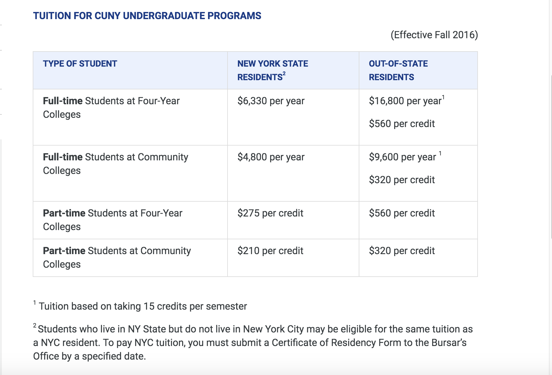

Slide 5
